Slide 1
CONDITIONAL STATEMENTS IN JAVASCRIPT
Sai Vardhan T

Slide 2
CONDITIONAL STATEMENTS IN JS
Conditional statements are defined as the statements which will be executed based on some conditions.
Here are the main control flow structures in JavaScript with clear examples for each:
IF STATEMENT
IF – ELSE STATEMENT
IF – ELSE IF – ELSE STATEMENT
SWITCH STATEMENT
Nested Conditional Statements

Slide 3
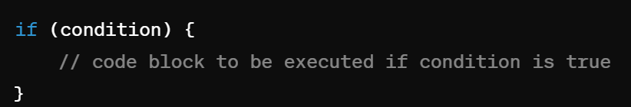
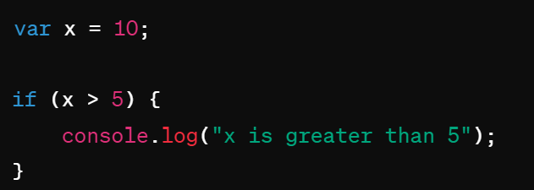
IF STATEMENT
The if statement executes a block of code if a specified condition is true.
SYNTAX:
EXAMPLE:

Slide 4
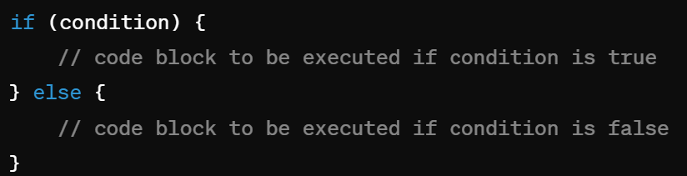
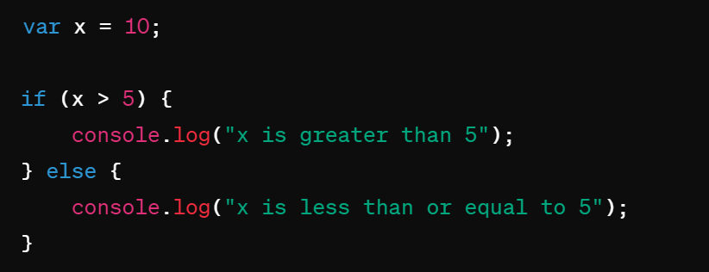
IF – ELSE - STATEMENTS
The if...else statement executes one block of code if a specified condition is true and another block of code if the condition is false.
SYNTAX:
EXAMPLE:

Slide 5
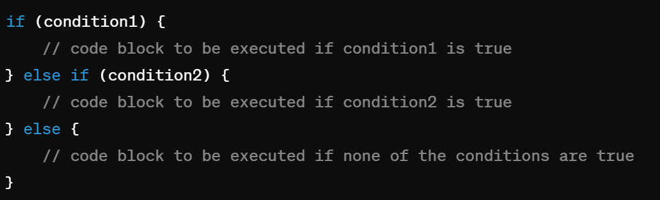
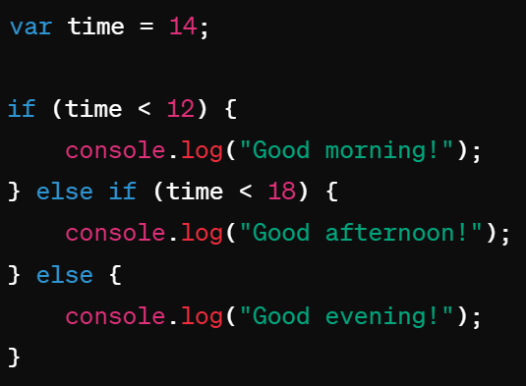
IF – ELSE IF – ELSE - STATEMENT
EXAMPLE:
The if...else if...else statement allows you to chain multiple conditions and execute different blocks of code based on the truthiness of those conditions.
SYNTAX:

Slide 6
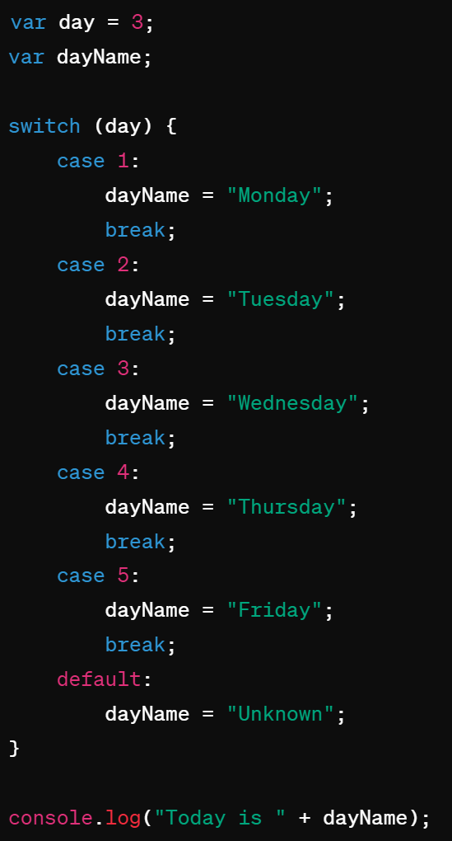
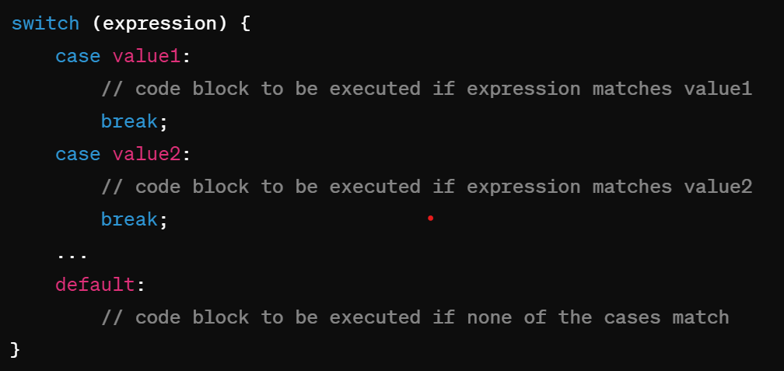
SWITCH CASE IN JS
The switch statement evaluates an expression and
executes a block of code depending on a matching
case label.
SYNTAX:

